Slide 1
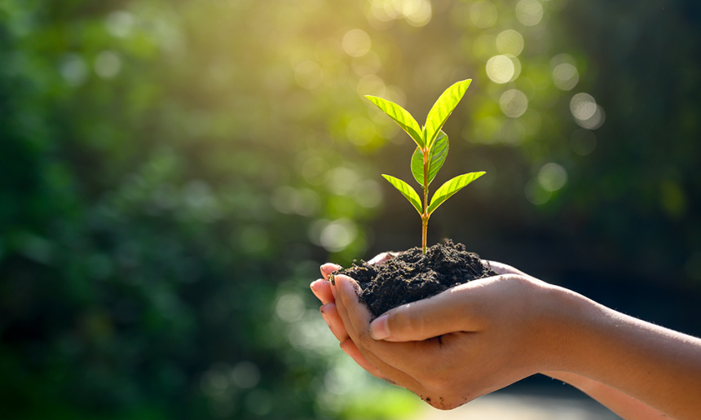
What Can I Do?
St. Peter’s Eco-Justice Council

Slide 2


Introduction
Disclaimer: this list is incomplete
Try to choose at least 3 actions
Make your sustainability efforts sustainable – think incrementally

Slide 3
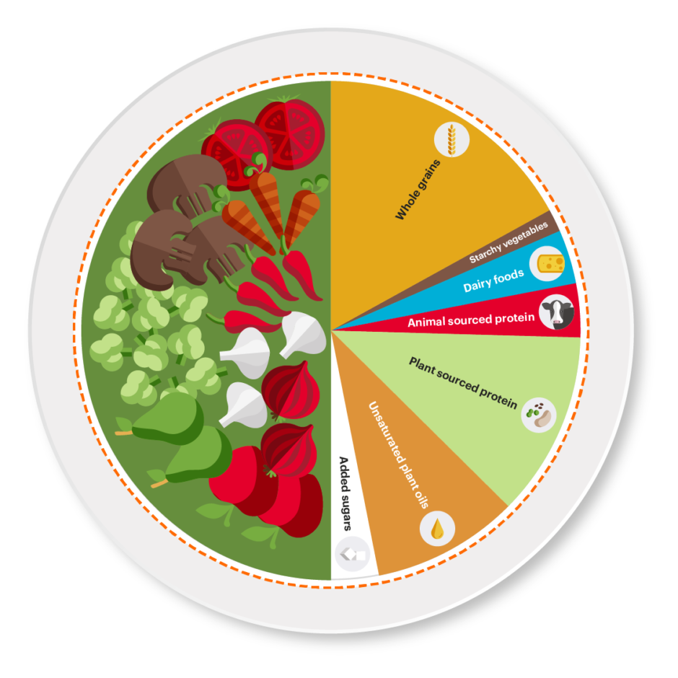
Planetarian Diet

Slide 4
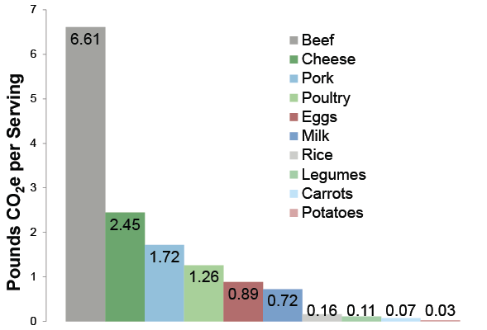
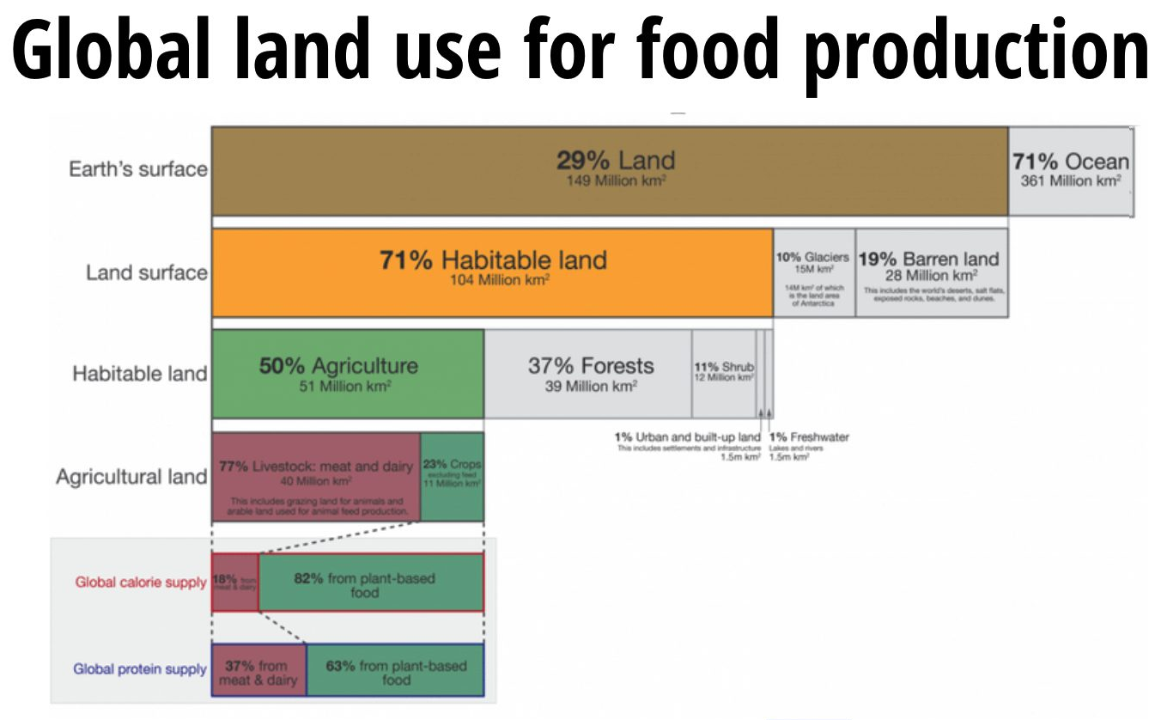
Why?
26% of Earth’s terrestrial surface is used for livestock grazing
Livestock production uses nearly 80% of global agricultural land
Meat accounts for nearly 60% of all Greenhouse Gases (GHGs) from food
Meat and Dairy only make up 18% of global caloric intake

Slide 5
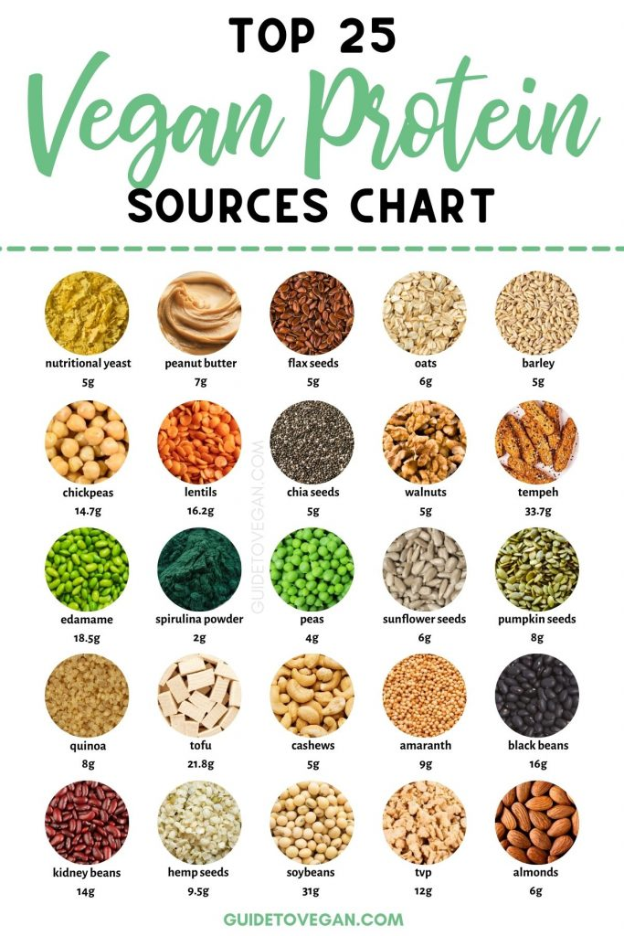
How?
Commit to one meatless meal a day
Drop one type of meat at a time – start with beef
Protein from a variety of plant-based sources
B12 vitamin supplement if you go vegan

Slide 6
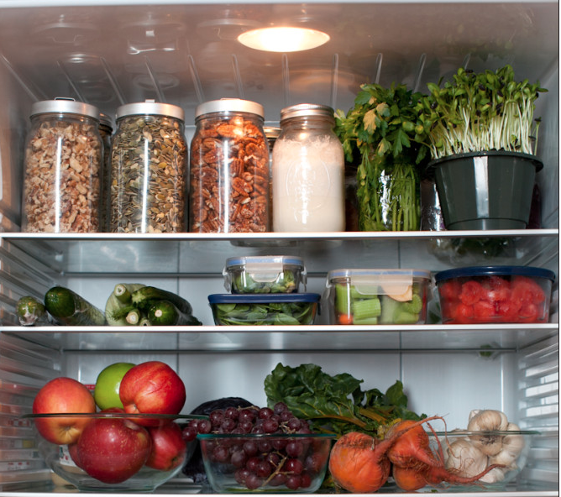
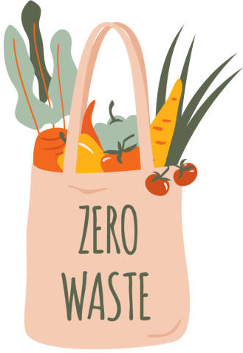
Reduce Food Waste

Slide 7
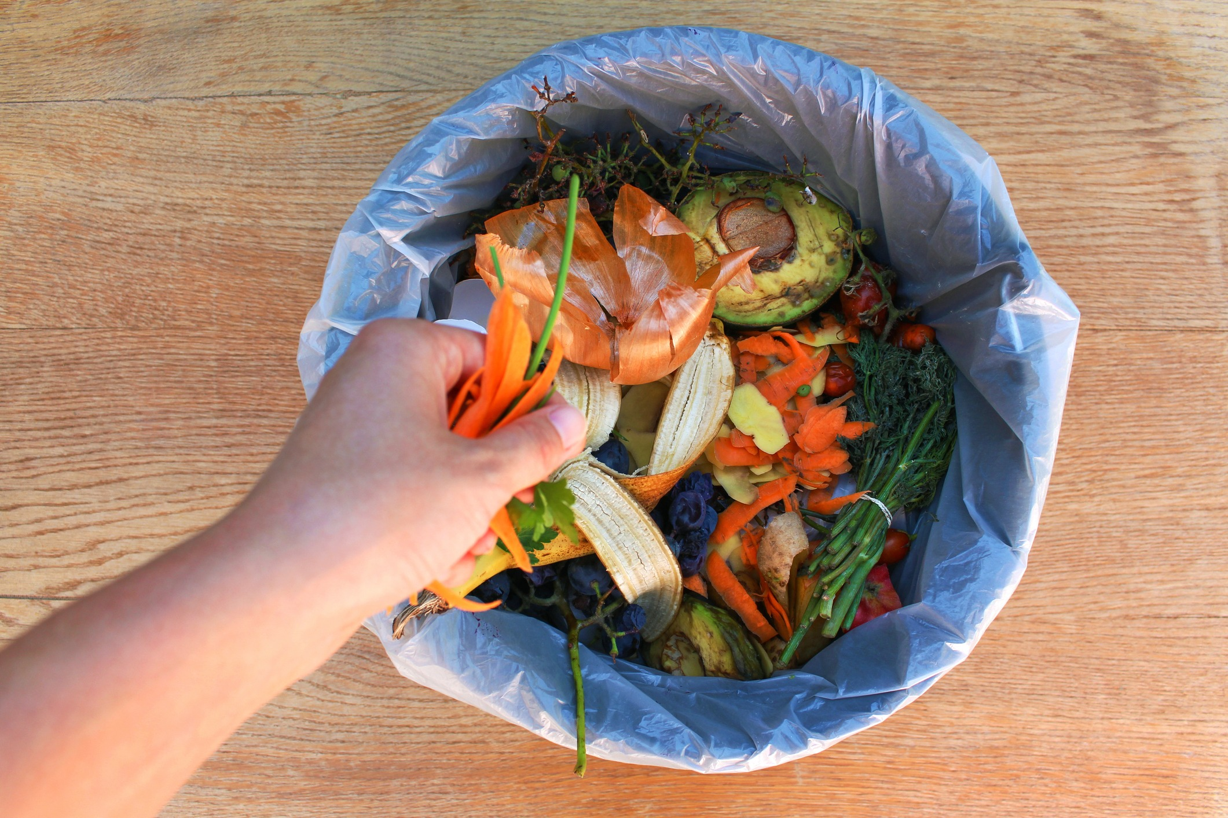
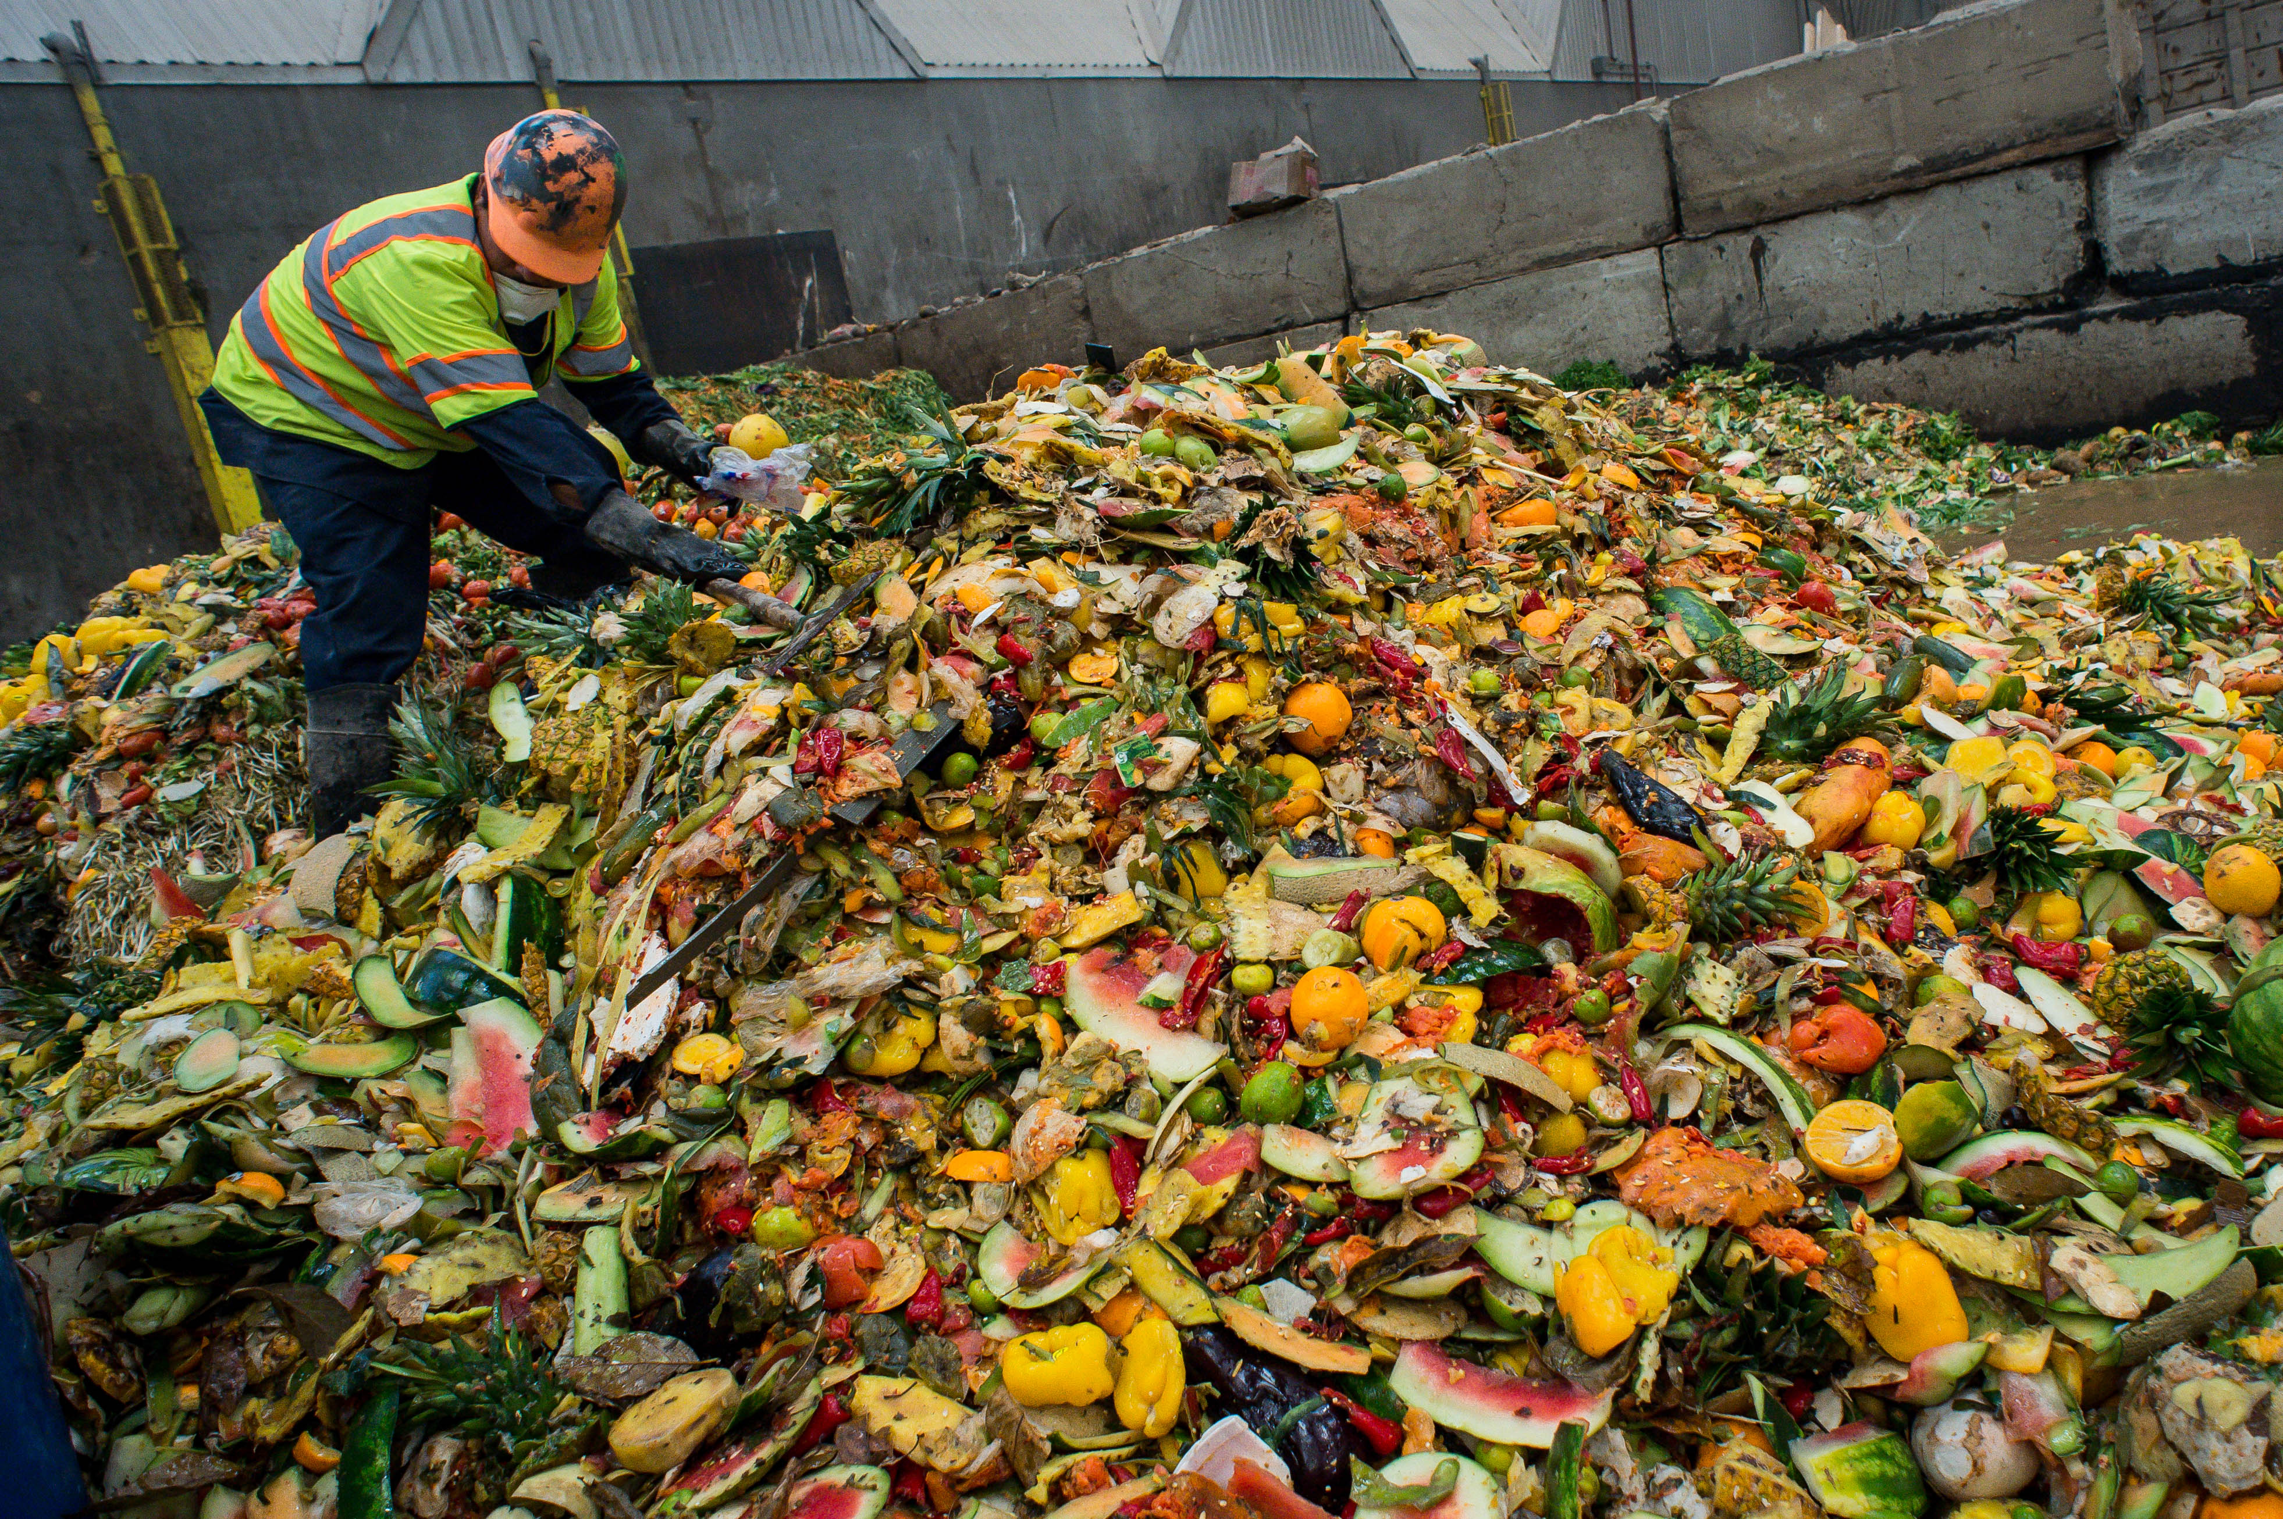
Why?
When food goes to landfill and rots, it produces methane (25x CO₂)
Global food loss & waste generate ~8% of anthropogenic GHGs
Estimated one-third of all the food produced globally goes to waste
Production of lost/wasted food = 32.6 mil cars on the road of GHGs

Slide 8
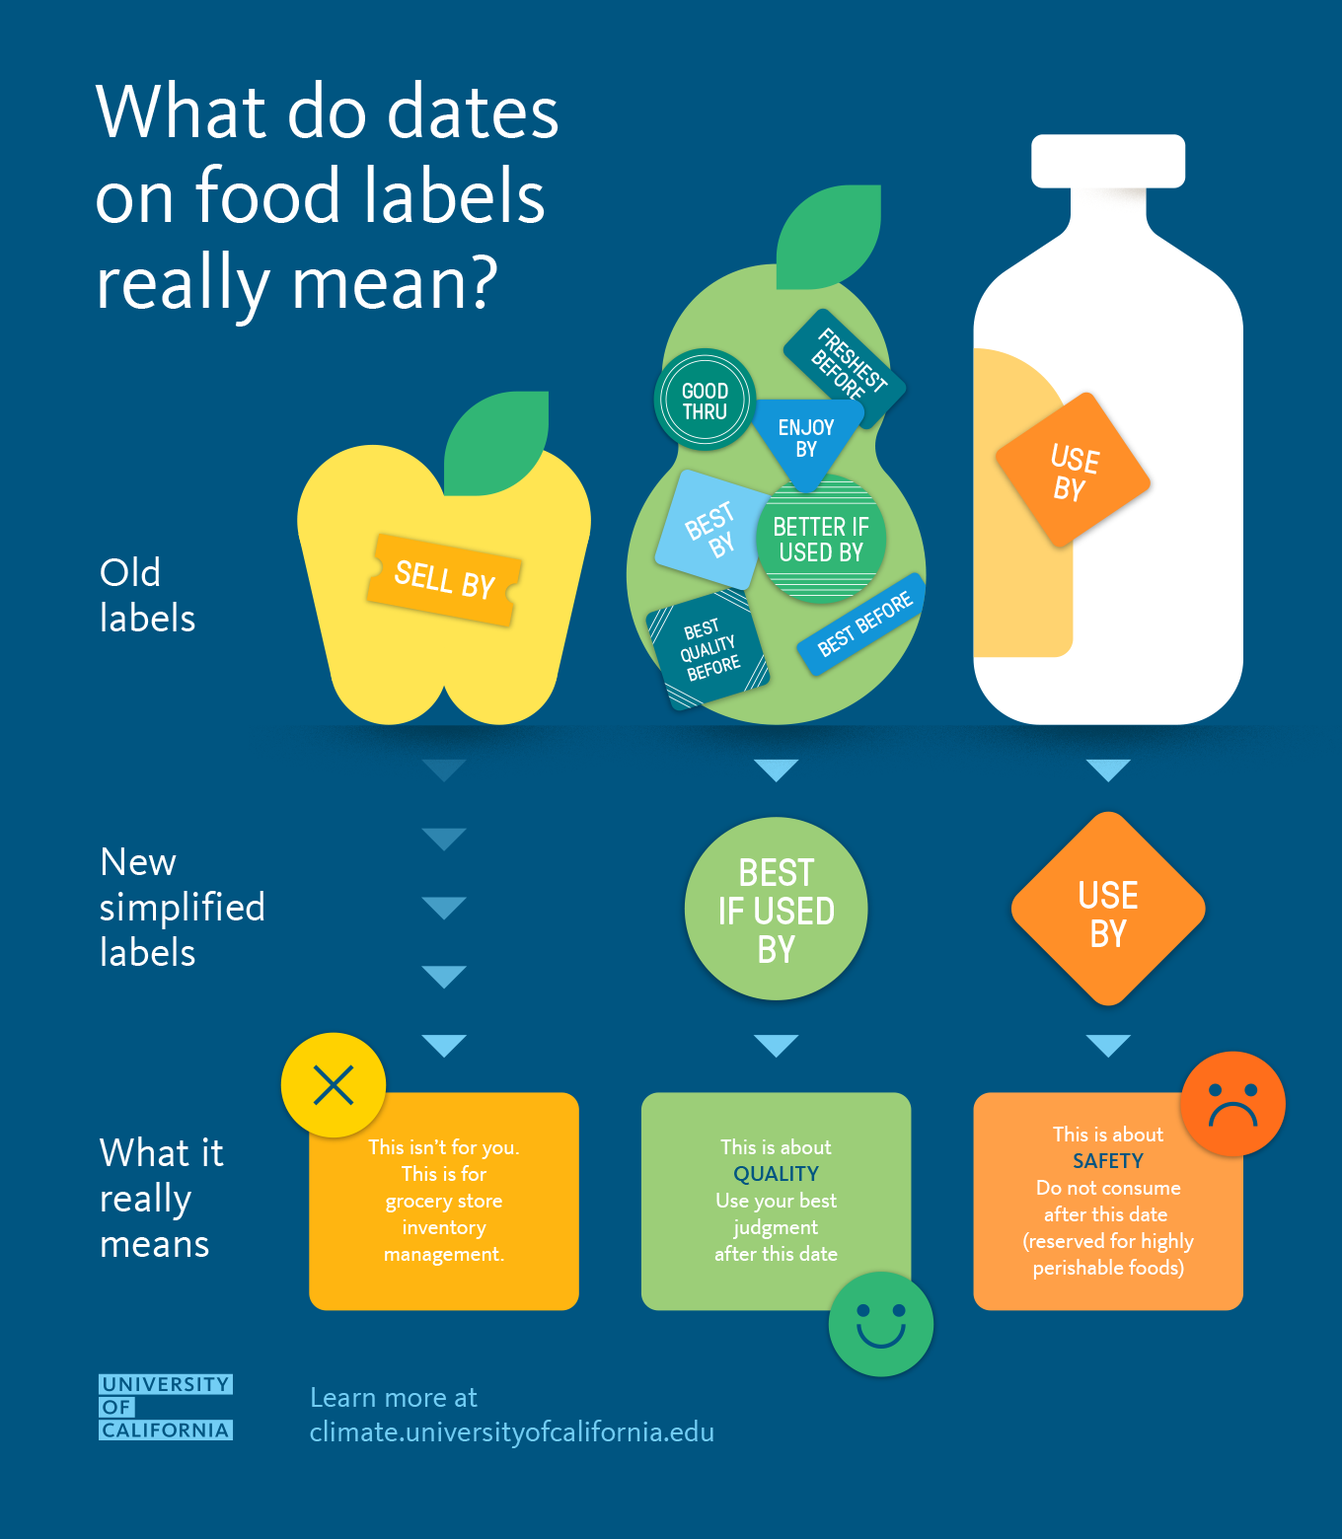
How?
Buy less & more frequently
Be careful when buying in bulk
Purchase imperfect foods

Slide 9
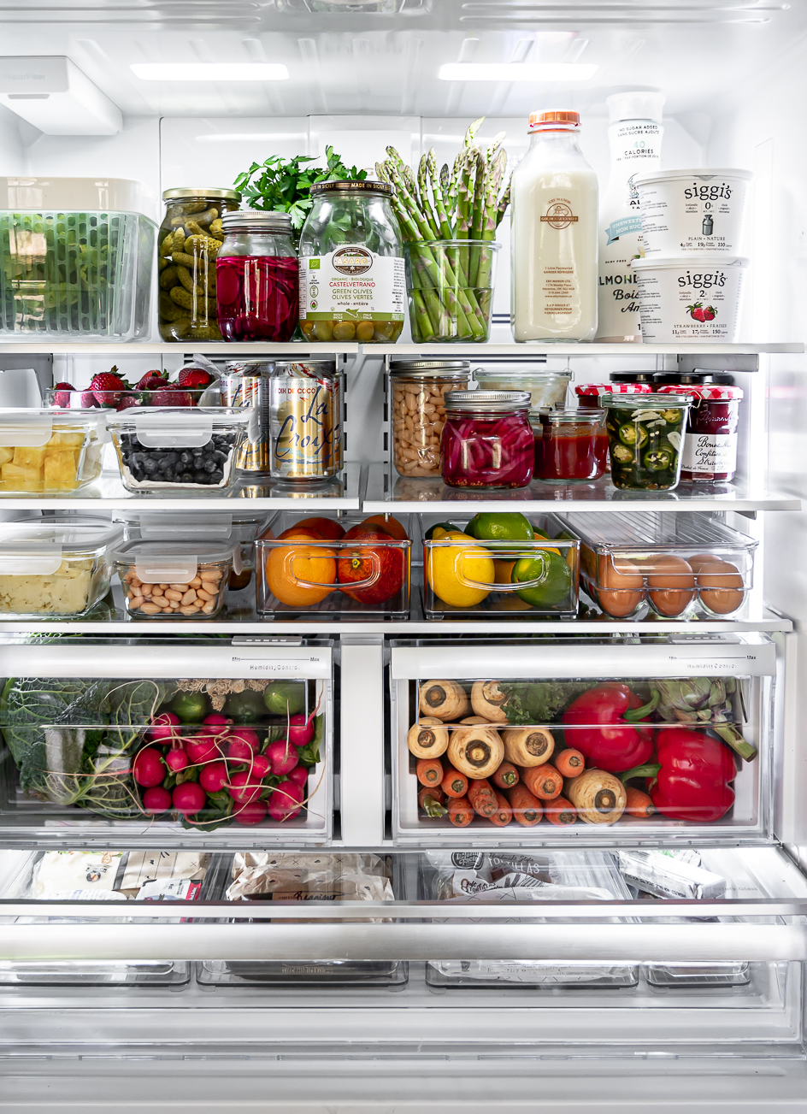
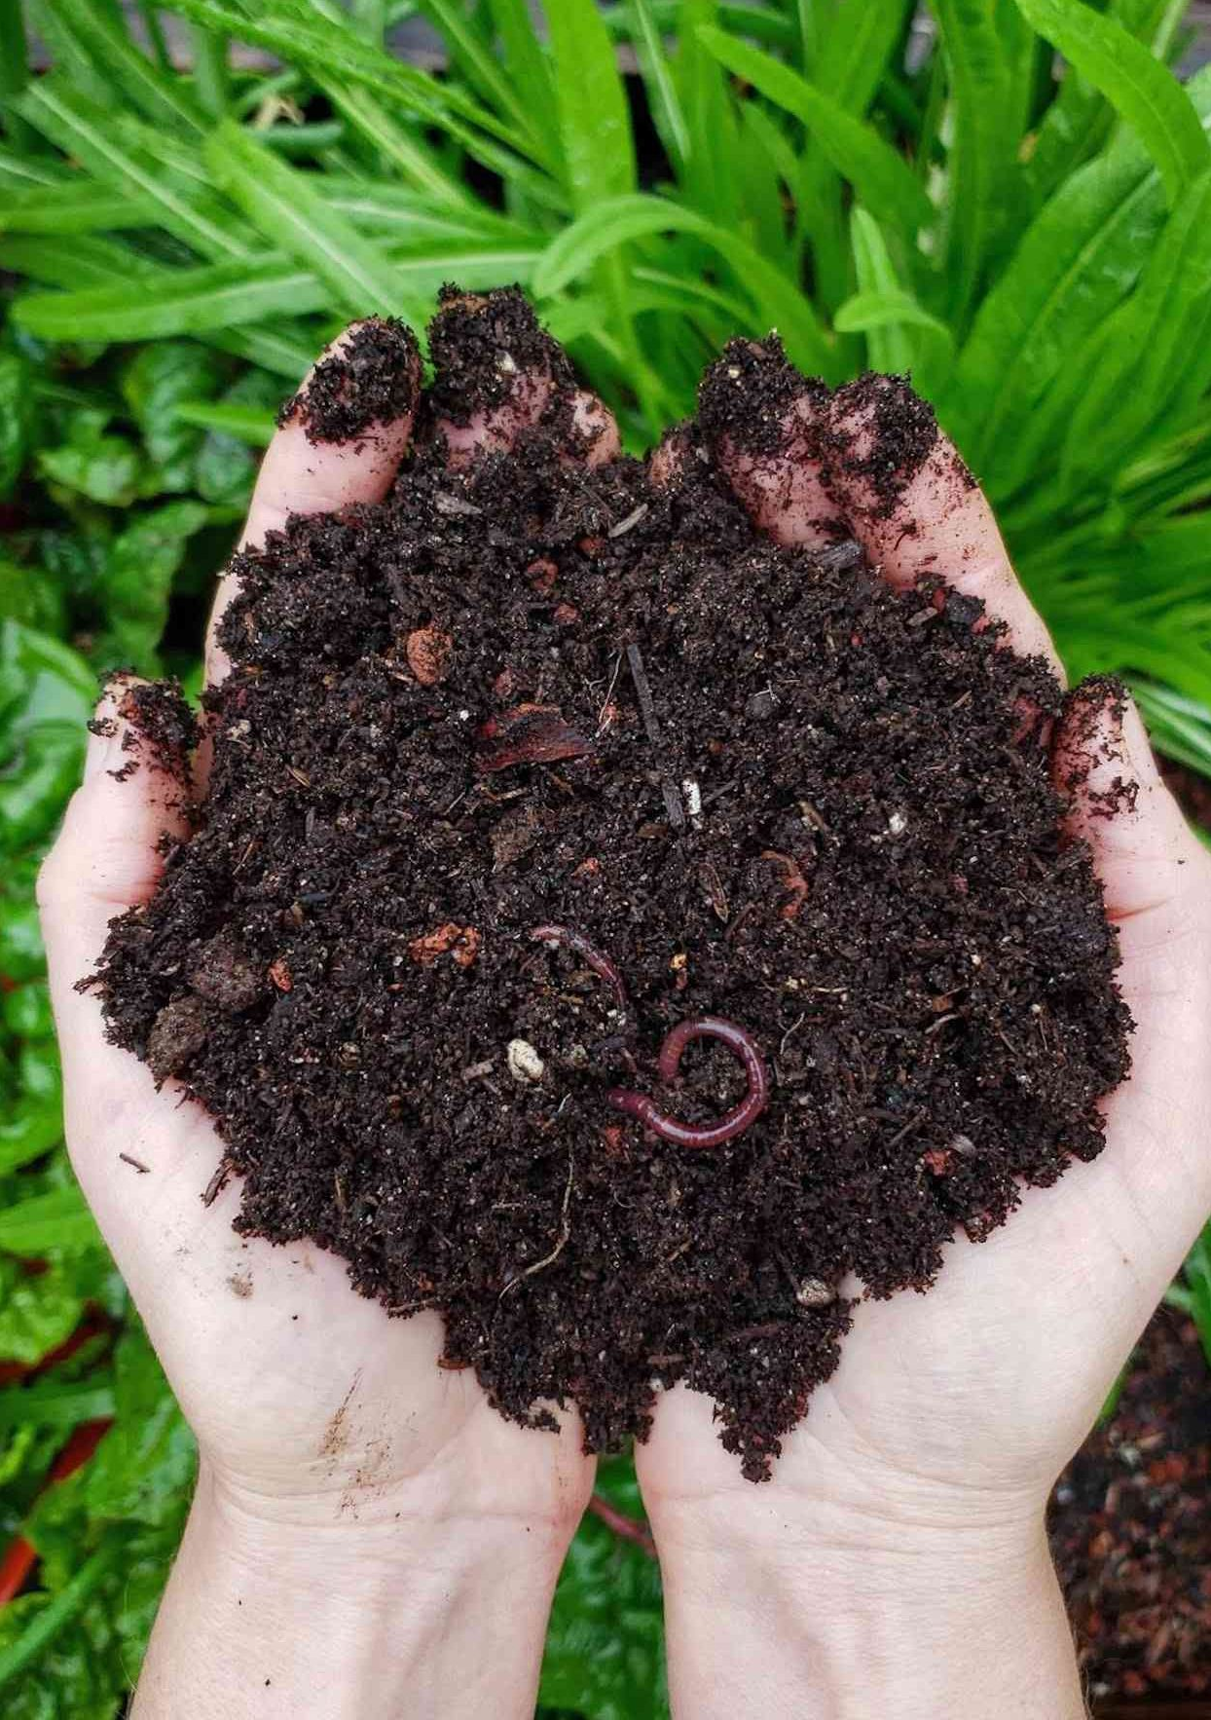
How?
Take stock of your fridge
Freezer <0°F, Fridge <40°F
Compost!

Slide 10
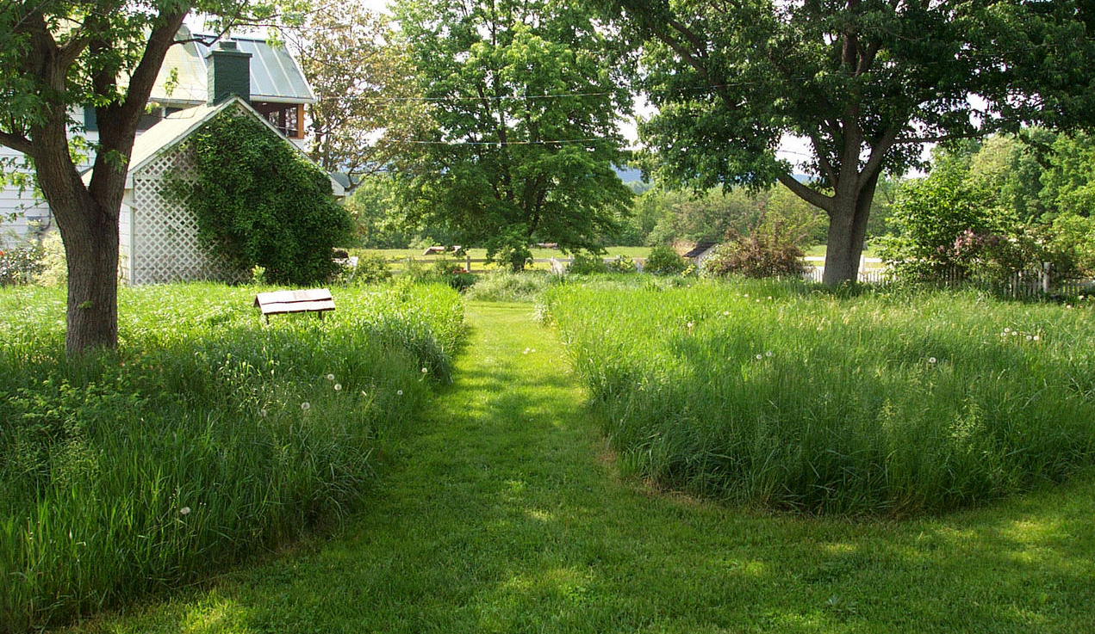
Natural Yard-Care

Slide 11
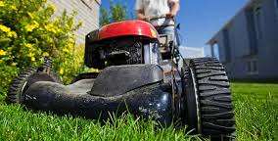
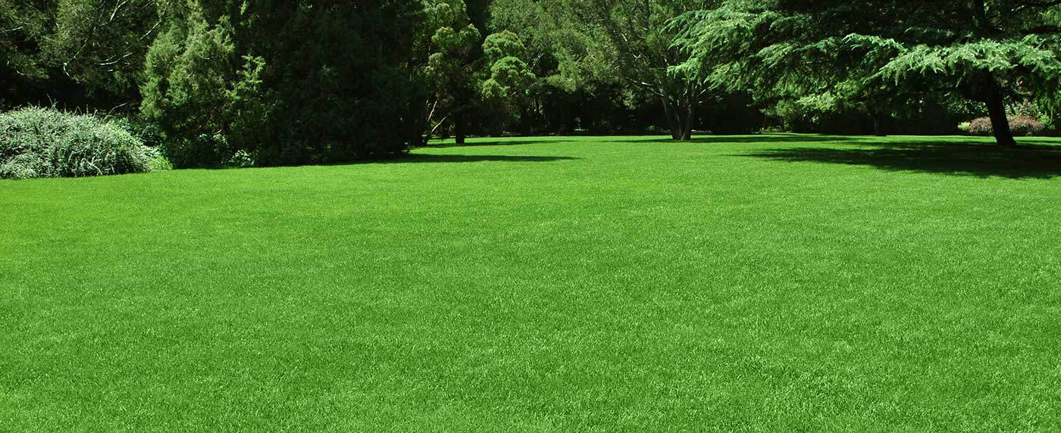
Why?
Lawns = barren wasteland for essential pollinators
Landscapers apply chemicals to lawns at >2x the concentrations in industrial agriculture
Pesticides and fertilizers pollute rivers via runoff
50% of irrigation water goes to waste

Slide 12
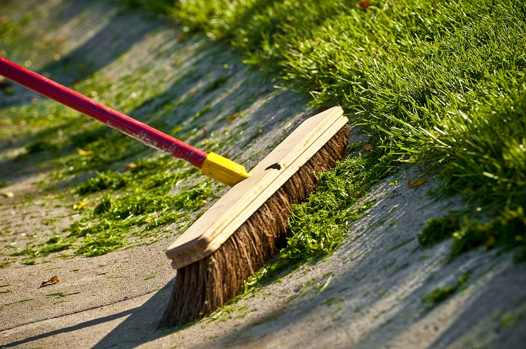
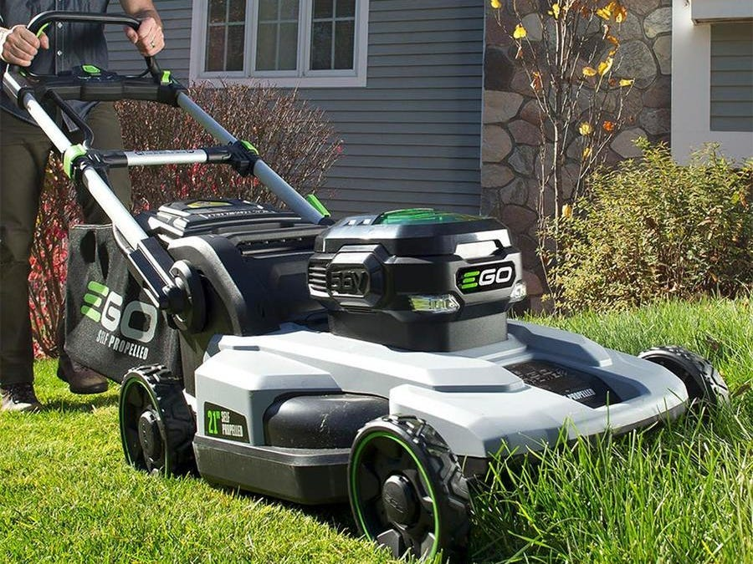
How?
Sweep grass clippings/leaves off of paved surfaces
Don’t use fertilizers or pesticides
Opt for an electric lawn mower, use it less
Try not to water your lawn

Slide 13
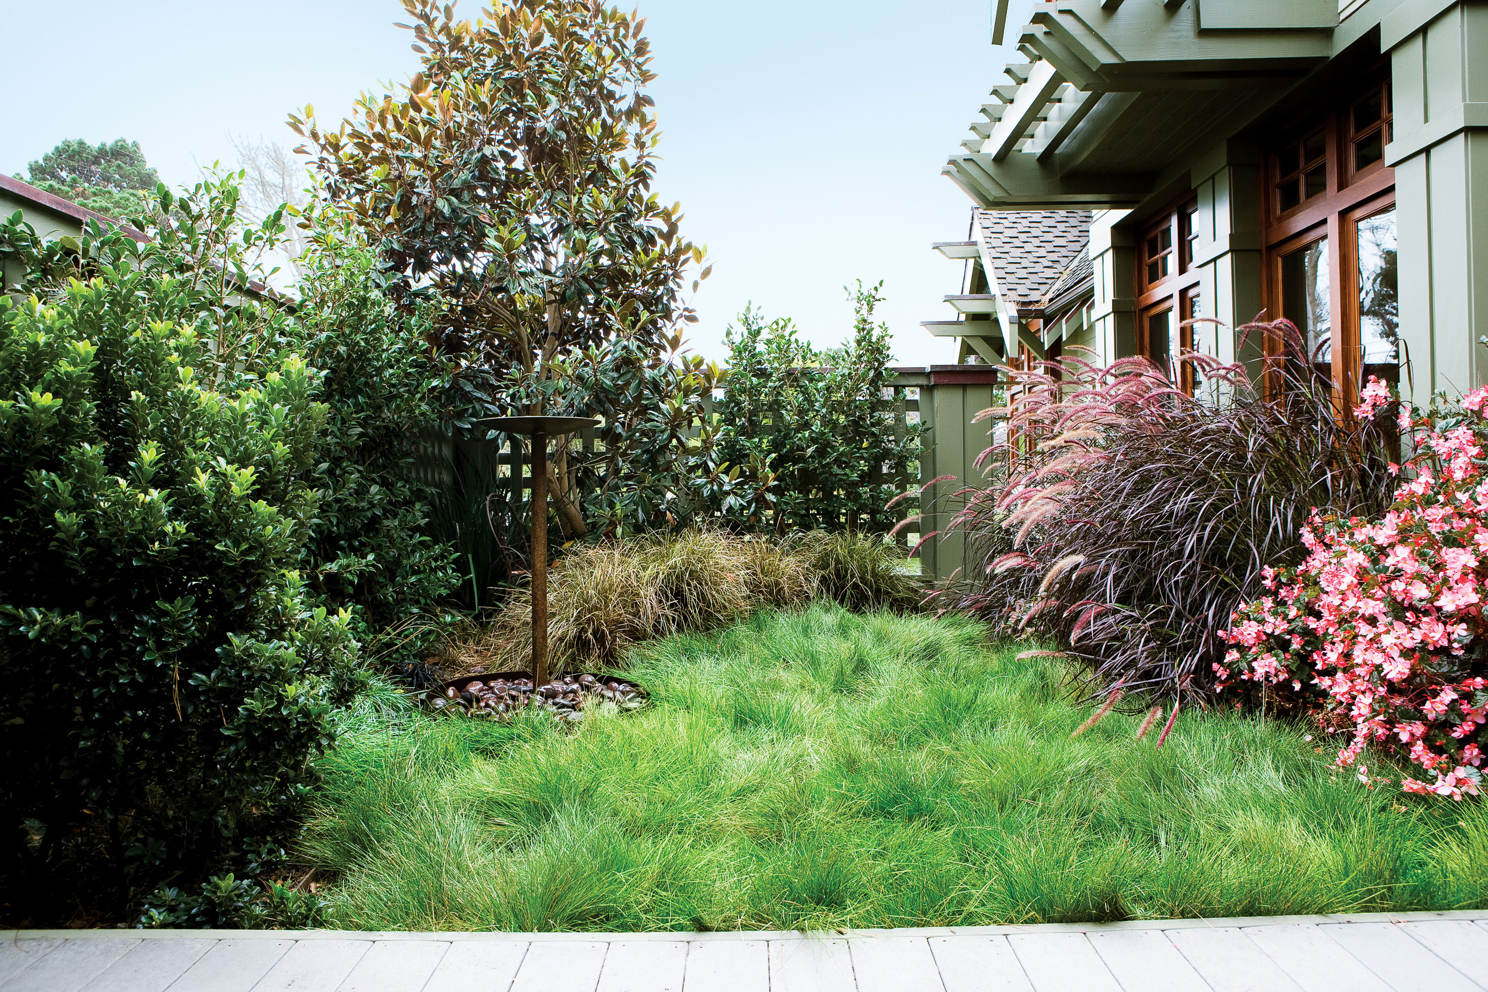
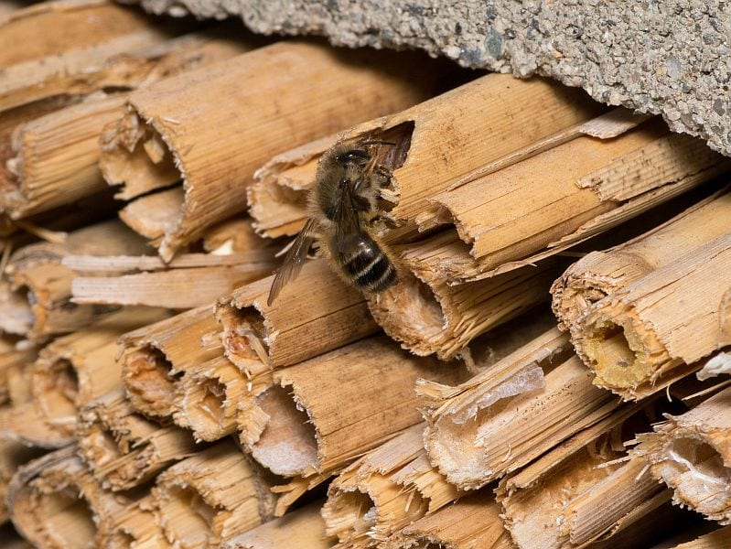

How?
Target weeding on invasives
Set aside an untampered portion of yard – Challenge norms
Plant native pollinator-friendly plants. We need bees!
Leave out dead wood and dirt patches for nesting bees
https://www.pollinator-pathway.org/copy-of-your-backyard

Slide 14
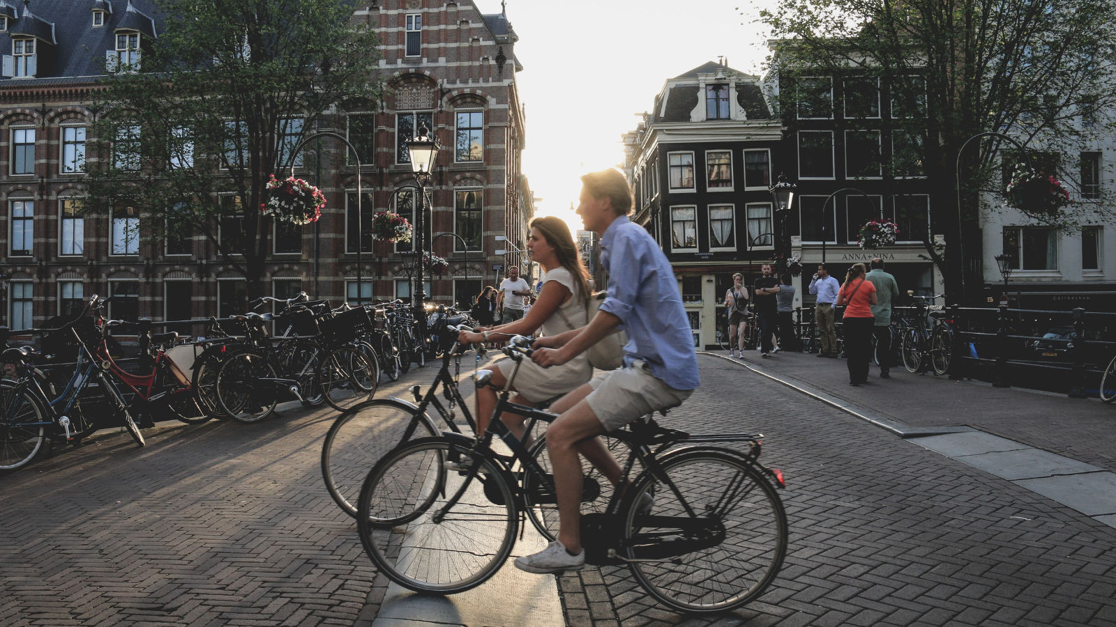

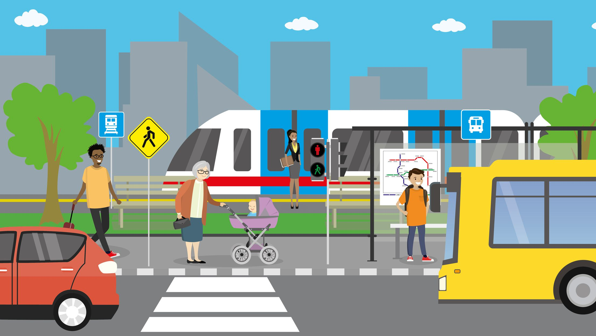
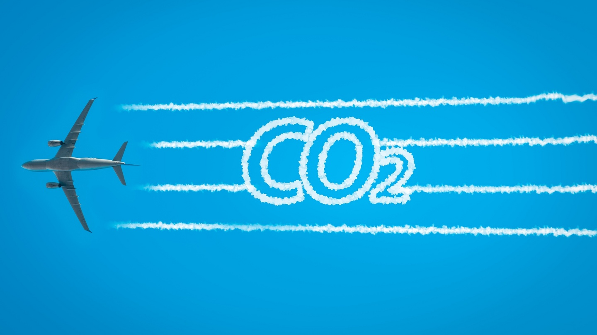
Travel Carbon- Conscious

Slide 15
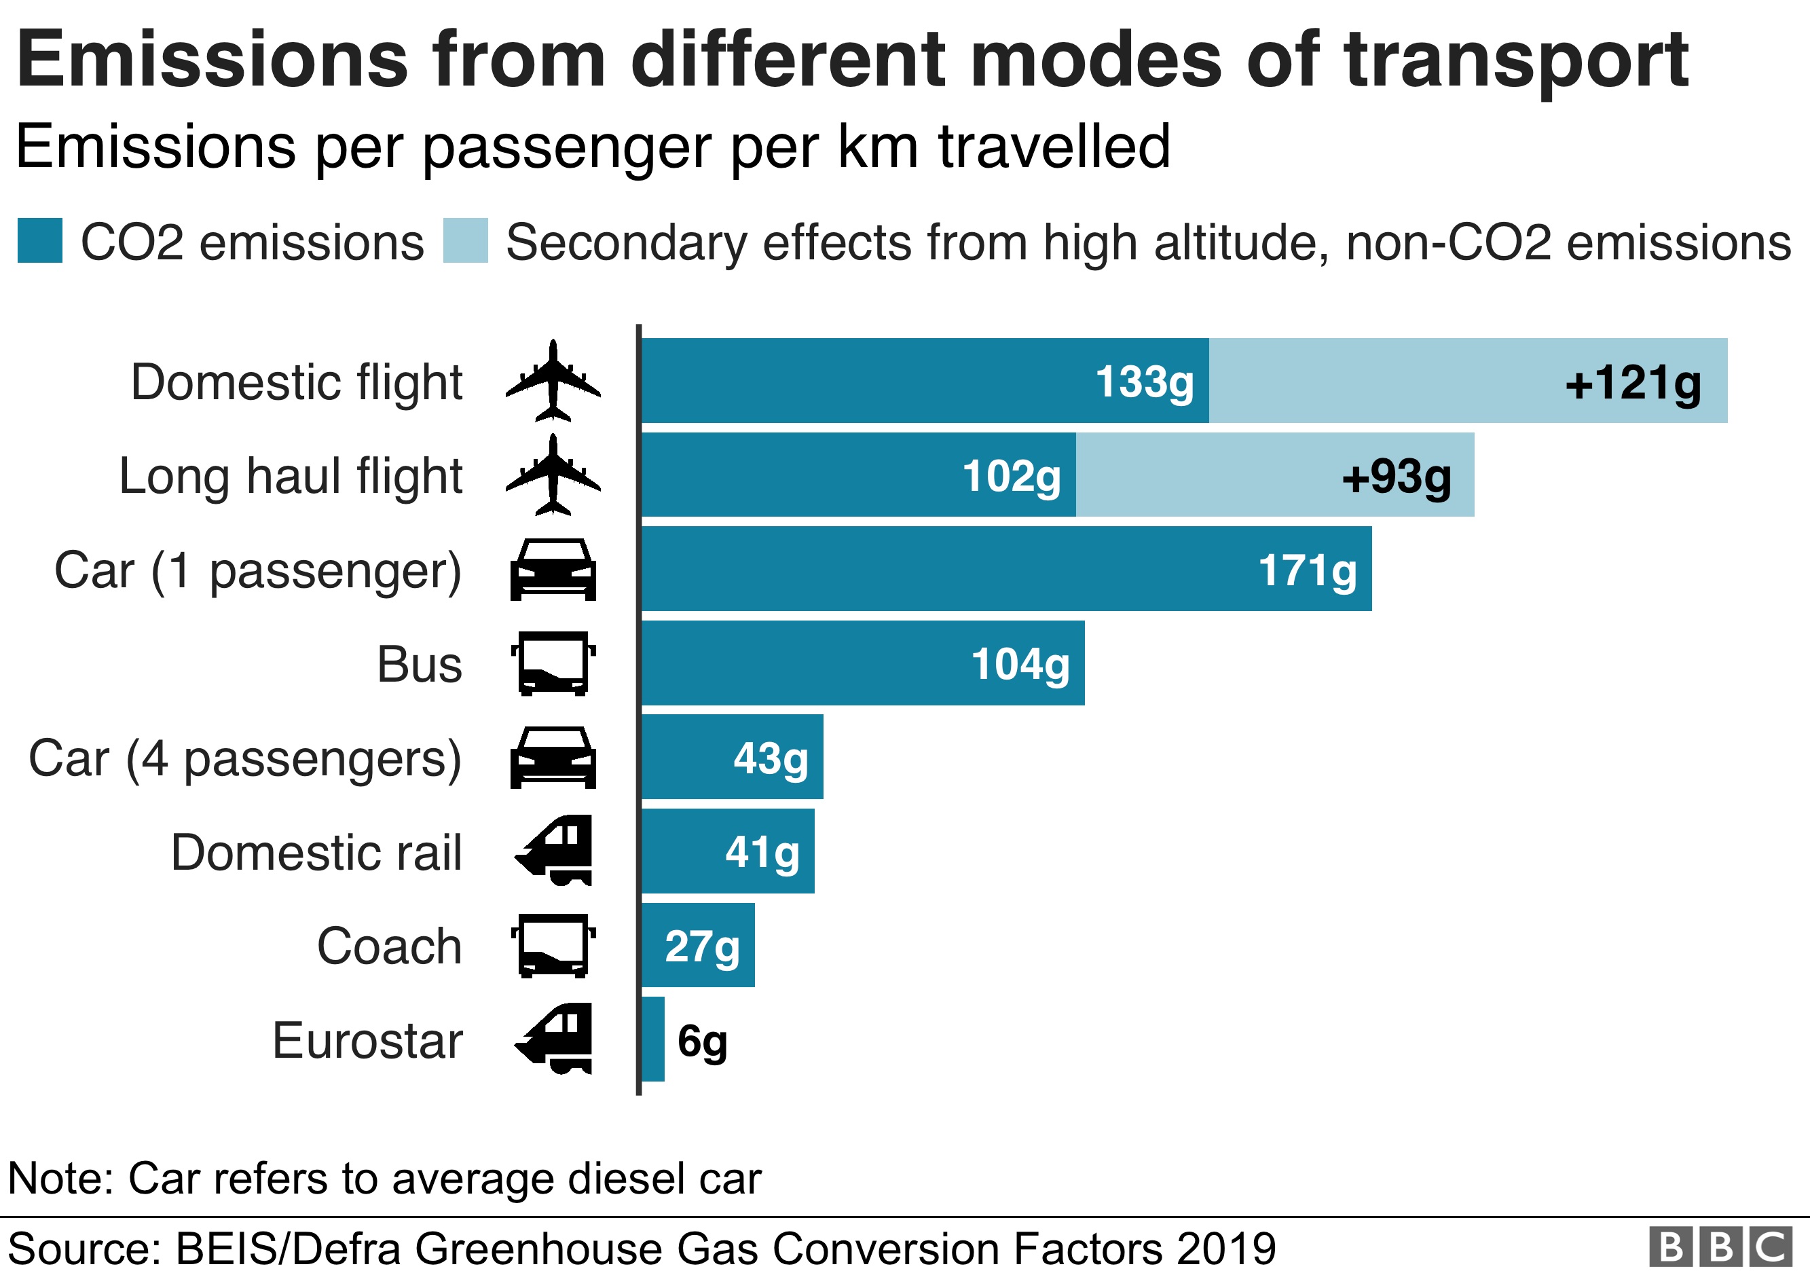
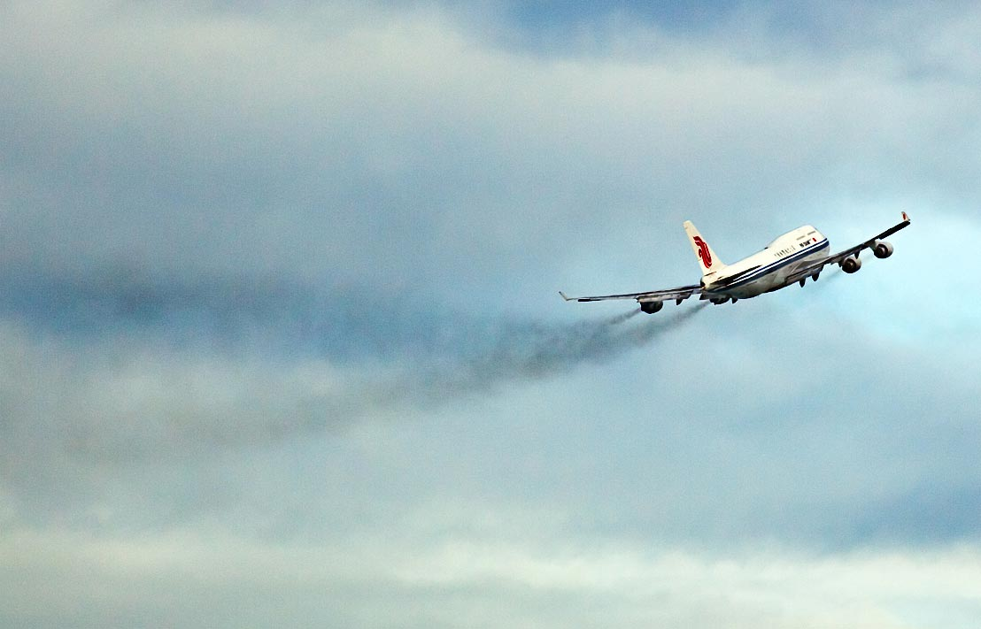
Why?
Air travel accounts for 2.5% of CO₂ emissions
Transportation sector - 29% of US GHGs
Burning of petroleum creates air pollution including nitrous oxides and particulates
Personal automobile transportation encourages sprawling development patterns, threatening habitats

Slide 16
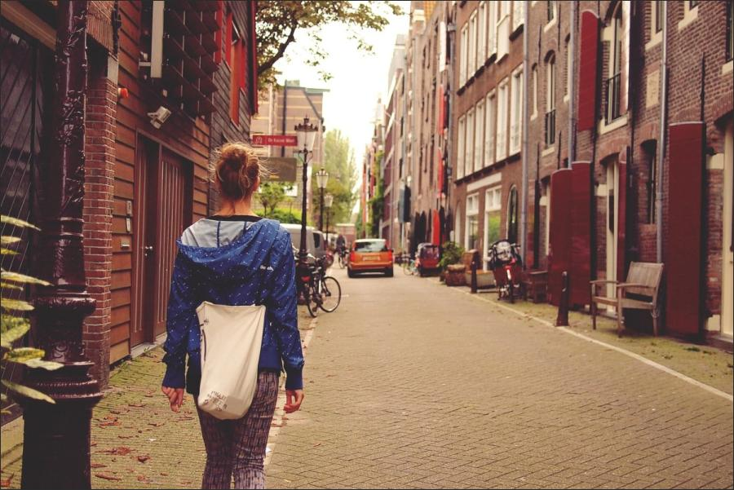
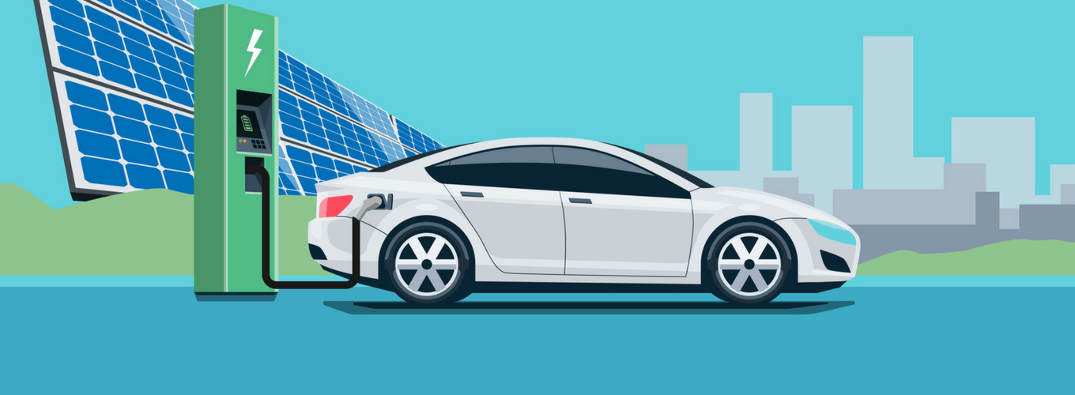
How?
Walk, cycle, use public transport, carpool
Make your next car an EV
Cut down on flights. When unavoidable: Book economy, pack light, choose direct flights

Slide 17

Aspire to Minimalism

Slide 18
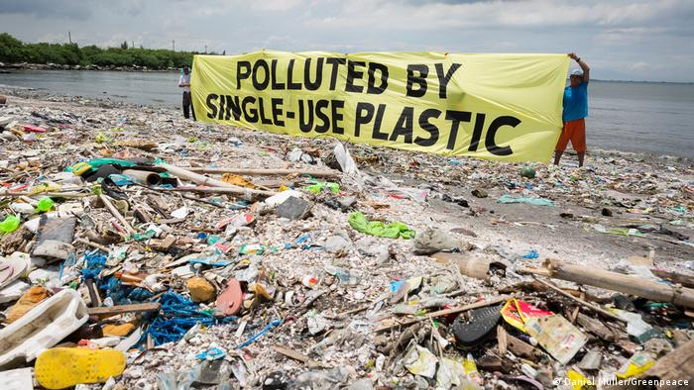
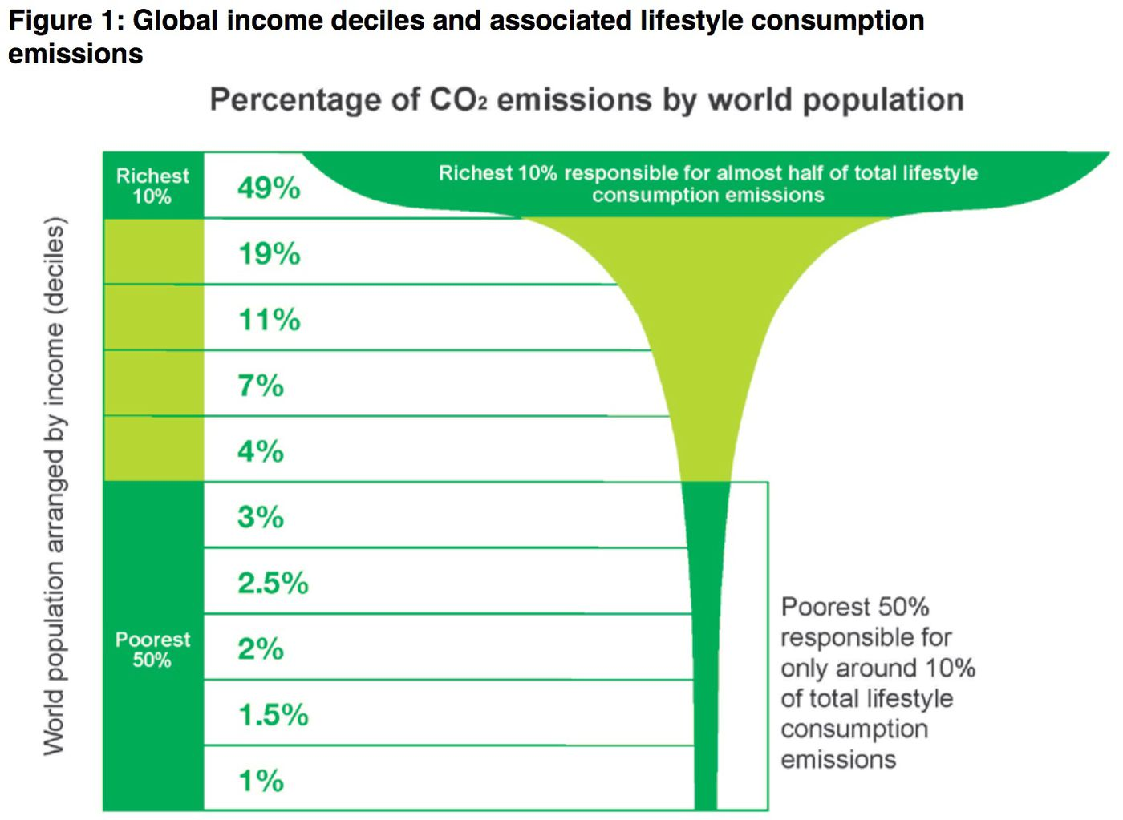
Why?
US: ~130kg of plastic waste annually per person, causing severe ecosystem damage
Consuming less products = producing less waste
45% of GHGs come solely from production of things we use and buy every day
Efficiency advancements have not kept pace with consumption

Slide 19
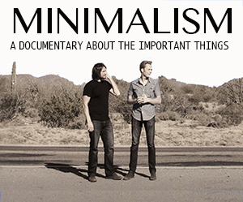

How?
Minimalist: someone who focuses on the immaterial elements of their life that truly matter and limits possessions which add little meaning to life
Check out Minimalism documentary
Search for reusable alternatives to single-use items

Slide 20
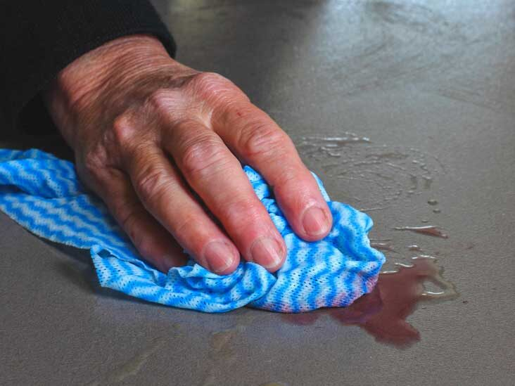
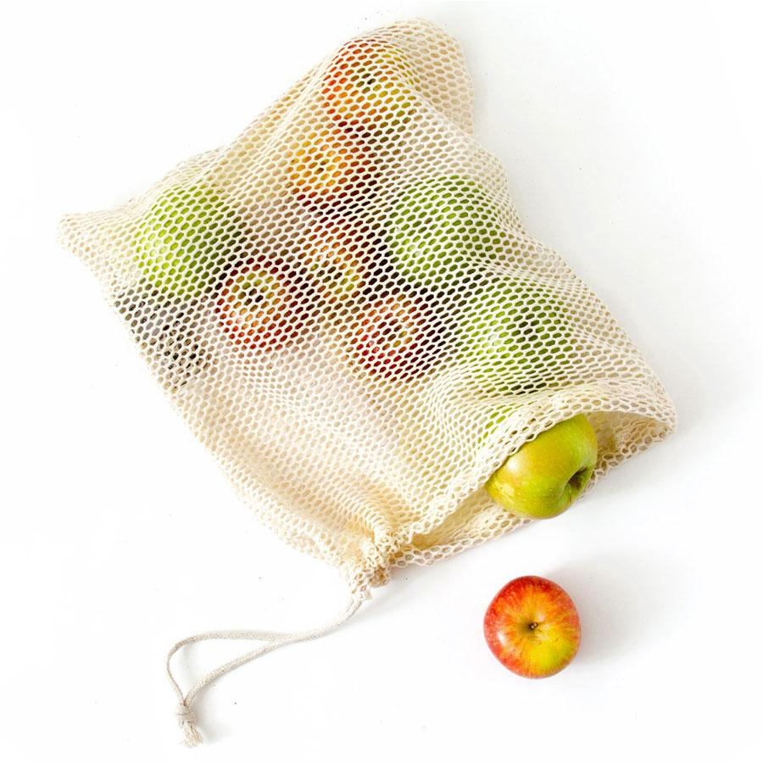
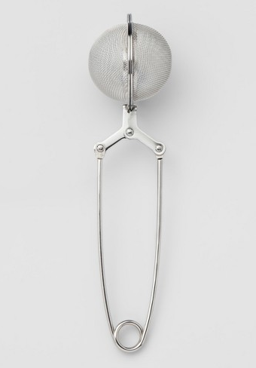
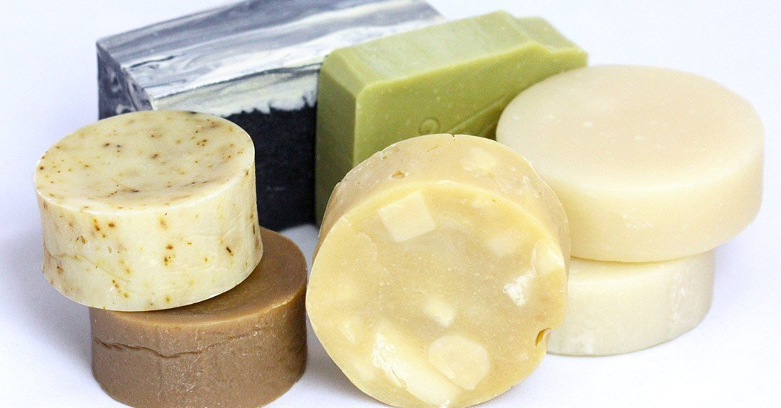
How?
Clean up kitchen messes with rags/towels, not paper towels
Use reusable bags and water bottles
Use bar soaps/shampoos instead of plastic bottles
Use reusable mesh grocery bags for produce
Use a stainless-steel tea infuser instead of single use teabags
Buy secondhand
Borrow and lend specialty items
Use bamboo toilet paper

Slide 21
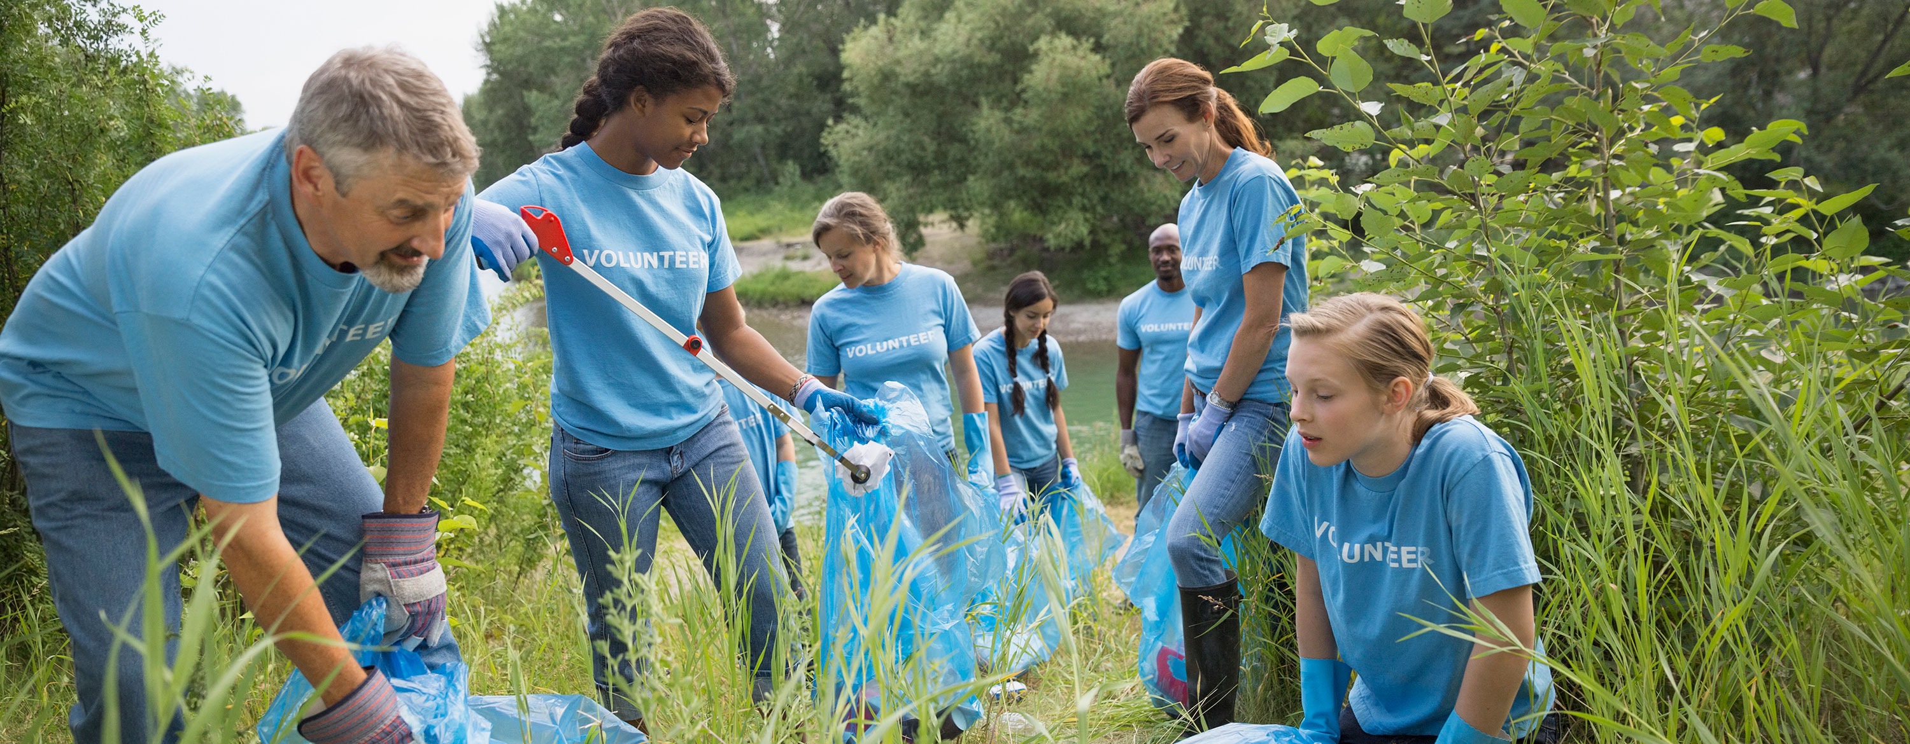
Work Collectively

Slide 22
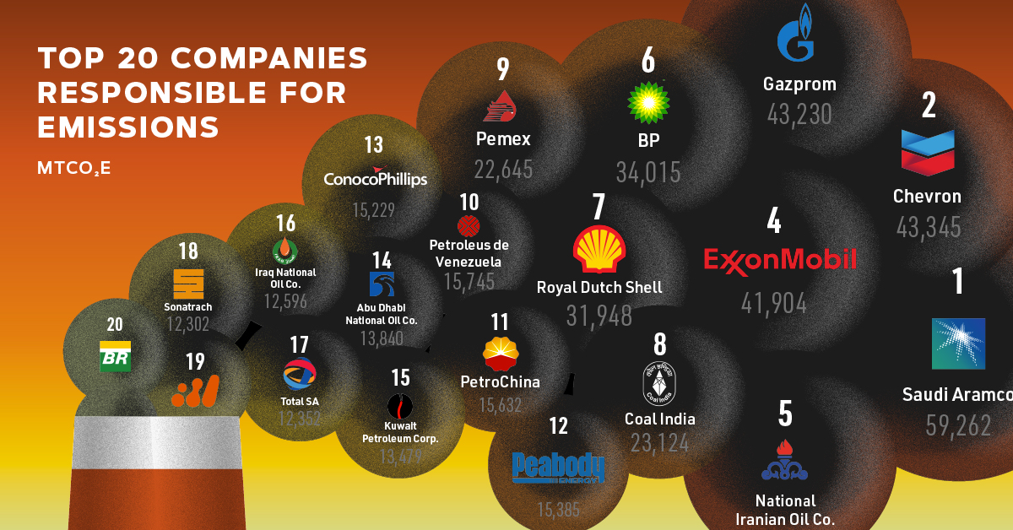

Why?
Environmental problems largely stem from our society’s economic structure
Collective political and social actions are required to effect change
Just 100 companies have been the source of more than 70% of GHG emissions
Need for innovative technologies

Slide 23

Why bother with individual efforts?

Slide 24

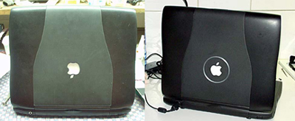
Individual → Collective
The sum of individual’s actions creates meaningful change
As individuals, we can drive down 25-30% of global emissions reductions needed to avoid the worst of climate change
Our individual actions don’t exist in a vacuum
Market your environmentalism (Referral marketing) – our behavior impacts others
VOTE!!! Contact your legislators, stay up to date
Connecticut League of Conservation Voters

Slide 25
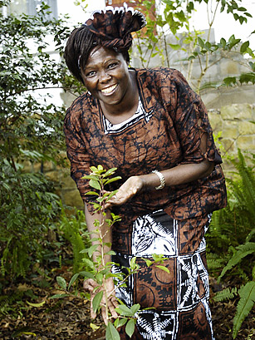
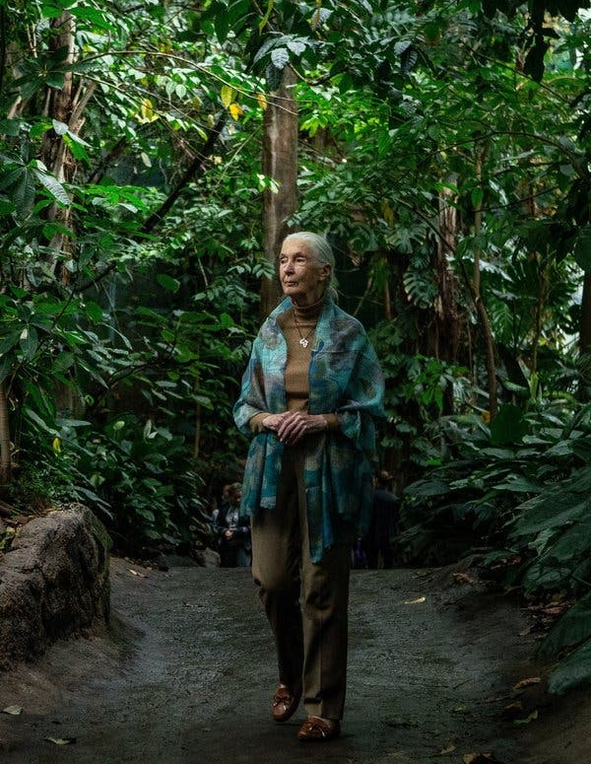
“What you do makes a difference, and you have to decide what kind of difference you want to make.” – Jane Goodall
“It’s the little things that citizens do. That’s what will make the difference. My little thing is planting trees. ” – Wangari Maathai

Slide 26
Questions/Discussion

Slide 27
Sources
Images
https://www.culinarynutrition.com/how-to-reduce-food-waste-best-zero-waste-recipes/ → Food waste
https://eatforum.org/learn-and-discover/the-planetary-health-diet/ → Planetarian
https://www.nytimes.com/2020/03/25/science/jane-goodall-coronavirus.html → Jane Goodall
https://greentomato.club/2021/07/27/your-guide-to-sustainability/ → Title slide
Transport:
https://tomorrow.city/a/an-efficient-public-transport-system-transforms-a-city-into-a-smart-city
https://www.irishtimes.com/business/innovation/how-airlines-are-working-to-reduce-their-co2-one-olive-at-a-time-1.4187942
https://businessupside.com/2020/10/06/shift-in-the-us-carpooling-market-a-car-pool-detail/
https://urbanmobilitycourses.eu/courses/designing-the-cycling-city/
Minimalism: https://www.decoist.com/cozy-minimalism/?chrome=1
Activism: https://www.britannica.com/explore/savingearth/environmentalism
Intro slide: https://www.volvogroup.com/en/sustainability.html
Food waste:
https://www.pasadenastarnews.com/2018/02/20/heres-how-food-waste-at-uci-some-supermarkets-is-being-converted-into-electricity/
https://earth.stanford.edu/news/when-food-waste-becomes-pollutant
https://www.sandravalvassori.com/how-to-organize-your-fridge-a-6-step-guide/
Lawn care
https://www.minnehahacreek.org/blog/5-tips-keeping-our-waters-clean
https://www.insider.com/guides/home/best-electric-lawn-mower
https://www.sunset.com/garden/garden-basics/plant-no-mow-lawn
https://www.ecolandscaping.org/12/landscaping-for-wildlife/beneficialspollinators/protecting-providing-nesting-native-bees-wasps/
Travel carbon conscious images
http://madeinatlantis.com/amsterdam/amsterdam-walking-around-the-town/
https://www.generalkinematics.com/blog/electric-vehicles-and-the-effect-on-the-metal-market/
https://www.bbc.com/news/science-environment-49349566
https://earthjustice.org/news/press/2014/epa-announces-first-steps-to-cut-carbon-pollution-from-aircraft

Slide 28
Sources (Continued)
Minimalism
https://visuresolutions.com/visure-requirements-reusability/
https://www.kolbetimes.com/minimalism-documentary-important-things/
https://www.vox.com/energy-and-environment/2017/12/1/16718844/green-consumers-climate-change
Collective action
https://blog.bonus.ly/creating-innovative-teams
https://www.visualcapitalist.com/companies-carbon-emissions/
Quotes
https://curious.earth/blog/climate-change-quotes/#:~:text=%E2%80%9CBy%20polluting%20the%20oceans%2C%20not,there%20is%20no%20planet%20B.%E2%80%9D&text=%E2%80%9CWe%20are%20the%20first%20generation,can%20do%20something%20about%20it.%E2%80%9D&text=%E2%80%9CBelieve%20in%20the%20power%20of%20your%20own%20voice.
https://www.yourtango.com/2018313744/best-environmental-quotes-save-the-earth
Food Waste: https://www.fao.org/fileadmin/templates/nr/sustainability_pathways/docs/FWF_and_climate_change.pdf
https://www.worldwildlife.org/stories/fight-climate-change-by-preventing-food-waste#:~:text=But%20wasted%20food%20isn't,more%20potent%20than%20carbon%20dioxide.
Meat and Dairy
https://www.smithsonianmag.com/travel/is-the-livestock-industry-destroying-the-planet-11308007/#:~:text=A%20212%2Dpage%20online%20report,by%20livestock%20feed%20crop%20cultivation.
Waste
https://www.theguardian.com/environment/2021/dec/01/deluge-of-plastic-waste-us-is-worlds-biggest-plastic-polluter#:~:text=Plastic%20waste%20has%20increased%20sharply,for%20every%20person%20in%20America.&text=Much%20of%20this%20plastic%20ends,streams%2C%20in%20the%20world's%20oceans.
https://www.theguardian.com/environment/2021/dec/01/deluge-of-plastic-waste-us-is-worlds-biggest-plastic-polluter#:~:text=Plastic%20waste%20has%20increased%20sharply,for%20every%20person%20in%20America.&text=Much%20of%20this%20plastic%20ends,streams%2C%20in%20the%20world's%20oceans.
https://news.climate.columbia.edu/2020/12/16/buying-stuff-drives-climate-change /
Activism
https://fleximize.com/articles/011784/power-of-referral-marketing#:~:text=What%20is%20referral%20marketing%3F,promote%20your%20business%20for%20you https://www.wired.com/2004/06/apple-downside-/

